Slide 1


COVID-19 SEVERITY Prediction
Deep learning : Prof. Sebastanio Battiato
Asad Aslam : 1000052142
Dario Pishvai : 1000003236
Harsh Mehta : 1000055155
SM Khizar Alam : 1000055853
Sameer Afzal : 1000052143

Slide 2
Contents
01 | Introduction
02 | Dataset
03 | Training Phase
04 | Testing phase
05 | Conclusion

Slide 3
Introduction
The project highlight the application of Convolutional Neural Networks (CNNs) using MATLAB for advanced image processing in artificial intelligence. CNNs, known for automatically learning hierarchical visual representations, are fine-tuned in MATLAB to improve accuracy and performance in diverse image processing tasks. The project signifies a significant leap forward, showcasing the potential of deep learning techniques for intricate pattern analysis and feature extraction in the evolving landscape of AI.
In the following project we look into chest CT scans of different COVID-19 patients and predict the severity of the disease.

Slide 4
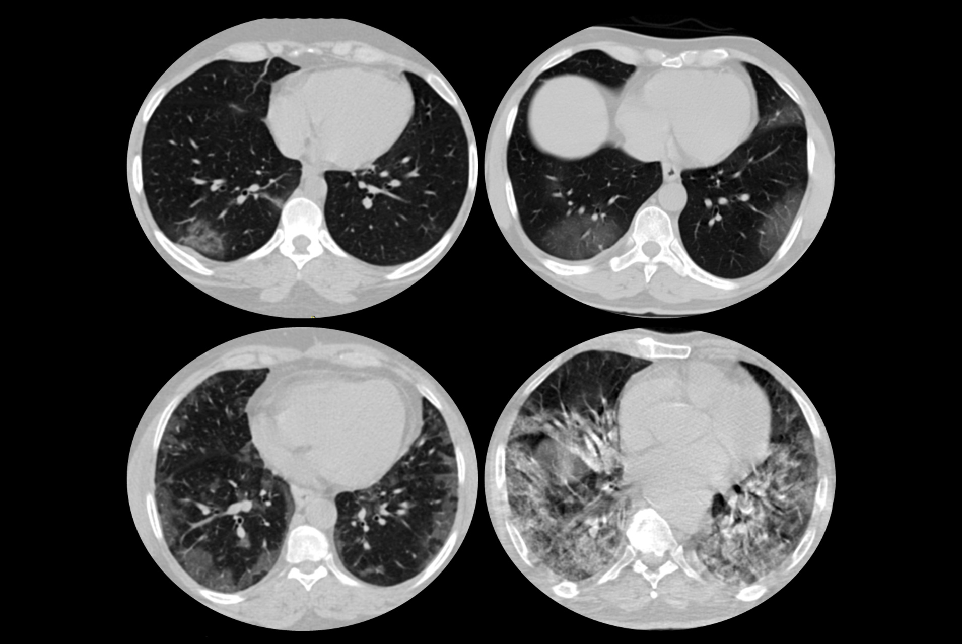
Data Set
The data set used have following features:
The images used are divided into smaller subgroups with the dimension
224 x 224 pixels
227 x 227 pixels
299 x 299 pixels
224 x 224 cropped images
Each Subgroup Organized with 40 Patients or Folders.
Fair Distribution Across Severity Types.
Training and validation split 70% and 30% respectively.

Slide 5
Data Set
Mild
For less than 25% severity
Severity type
Moderate
for 25-50% severity
Severe
For 51-75% severity
Critical
For more than 75% severity

Slide 6
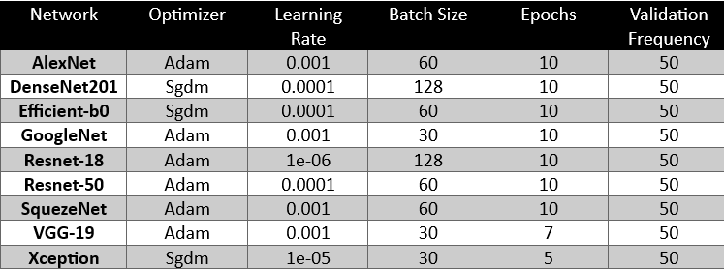
Training Phase
The table represents different types of hyperparameters with different networks. Following are the best hyperparameters according to the networks.

Slide 7
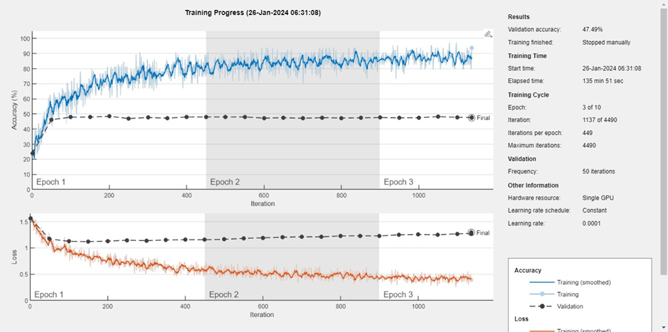
Training Phase : AlexNet
Training Accuracy: 30.00%

Slide 8
Training Phase : DenseNet201
Training Accuracy: 47.49%

Slide 9
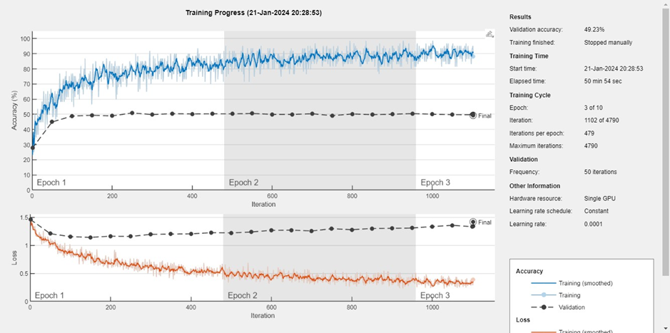
Training Phase: Efficient-b0
Training Accuracy: 49.23%

Slide 10
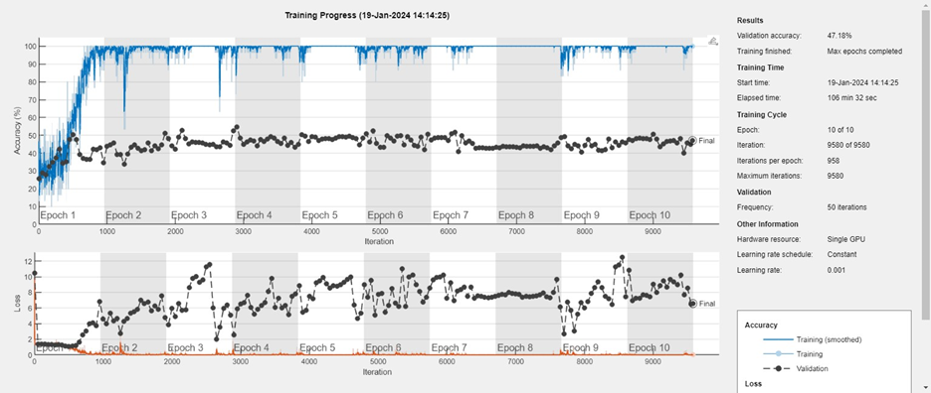
Training Phase: GoogleNet
Training Accuracy: 47.18%

Slide 11
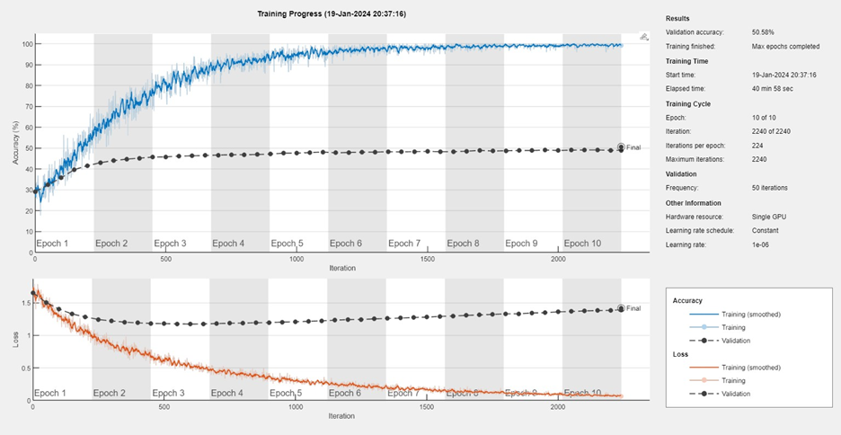
Training Phase: ResNet-18
Training Accuracy: 50.58%

Slide 12
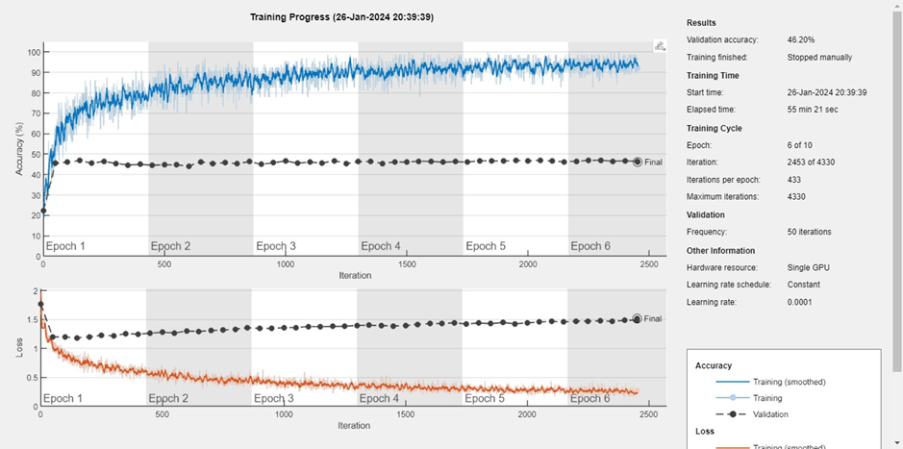
Training Phase: ResNet-50
Training Accuracy: 46.20%

Slide 13
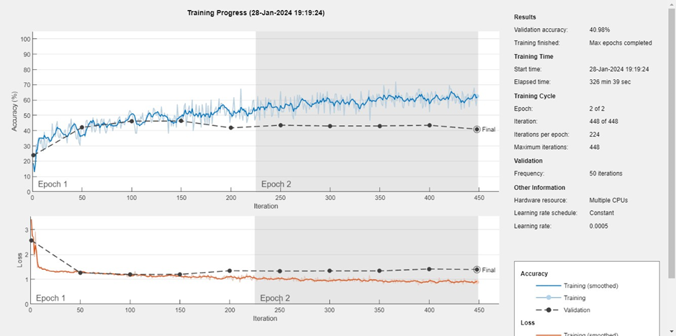
Training Phase: SqueezeNet
Training Accuracy: 40.98%

Slide 14
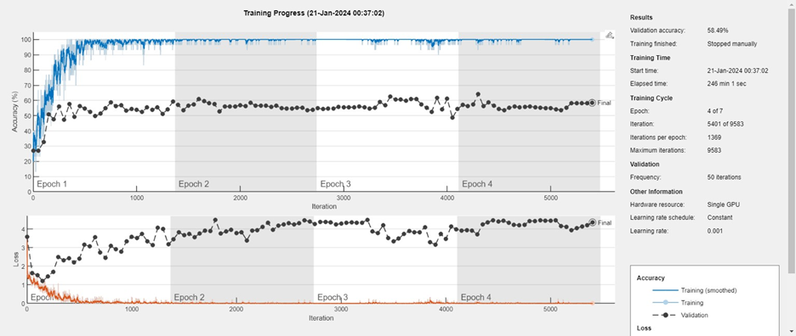
Training Phase: VCG-19
Training Accuracy: 58.49%

Slide 15
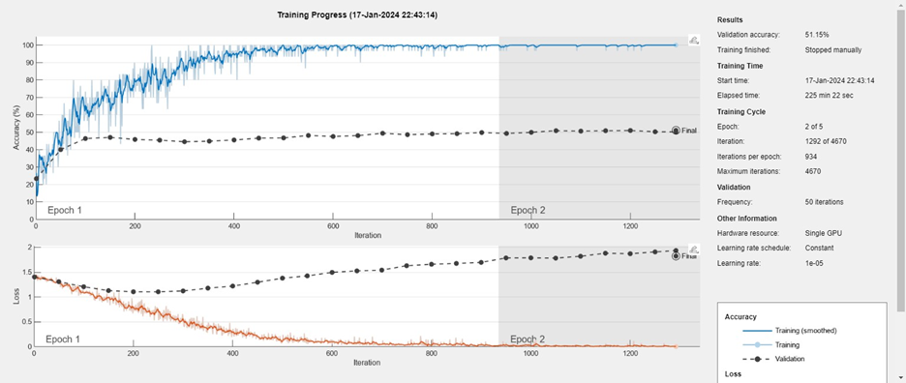
Training Phase: Xception
Training Accuracy: 51.15%

Slide 16
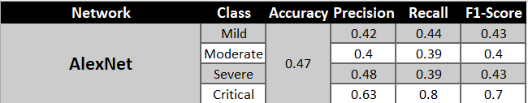
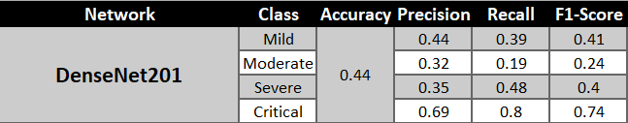
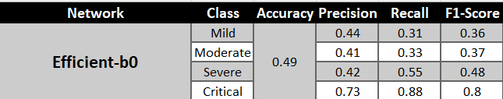
Testing Phase

Slide 17
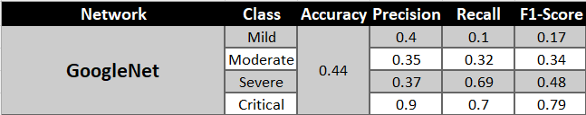
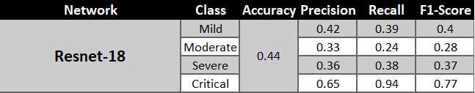
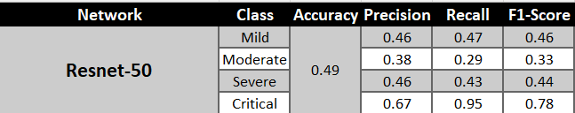
Testing Phase

Slide 18
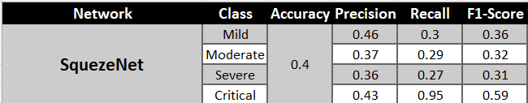
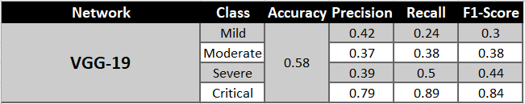
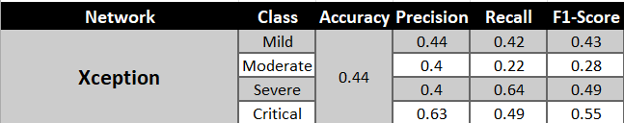
Testing Phase

Slide 19
Conclusion
So as we can see, the highest accuracy is reached by the VGG-19. Analyzing the obtained metrics we see that the 4th type of Severity is easier to classify compared to the classes. The low scores in the other classes, maybe, depends on the quantity of images used to put in evidence some patterns. These low scores carry out because our computations' power is very low, so we use a subset and a few epochs to train the architectures. Another problem that we try to solve, but with no result, is the overfitting. We try: adding dropout layers, or regularizing the data, and introducing a sort of learning rate decay.

